Slide 1
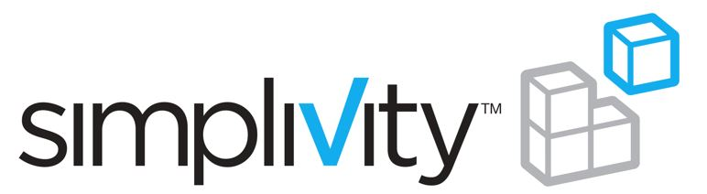

Get Hyperconverged with
and
May 2015

Slide 2

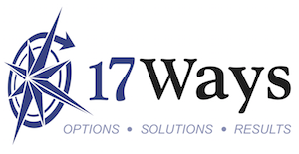
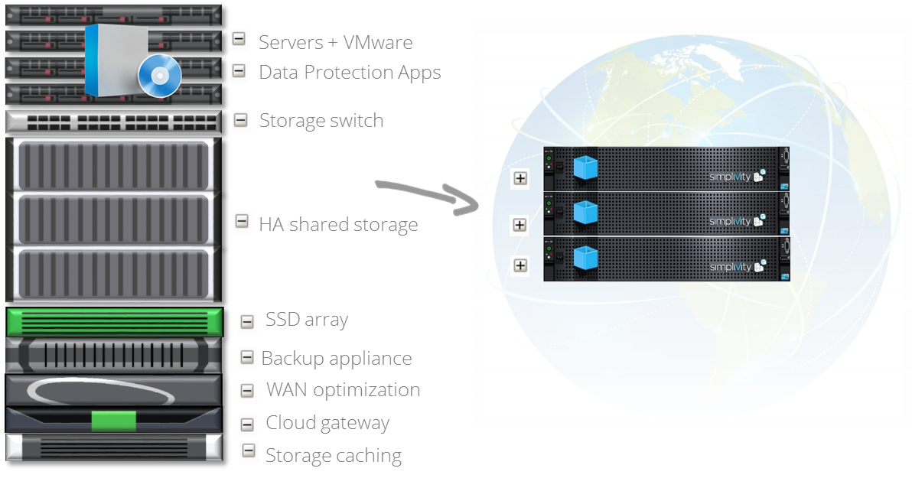
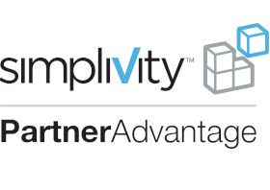
Get Hyperconverged with
and
Join the Web Scale revolution with SimpliVity’s hyperconverged solution. SimpliVity brings cloud-like economics to the data center with it’s scalable, modular 2U building blocks running on commodity x86 hardware.
Deploy and manage your virtual server environment with ease. SimpliVity’s Global Unified Management snaps straight into vCenter for simple and efficient management of your environment through a single pane of glass.
Get pure performance with SimpliVity’s real time de-duplication, compression and optimsation. Data is de-duped and compressed once and forever at the source. The best IO is the one you don’t have to have!
Experience security and peace of mind, as SimpliVity's powerful data management, data protection and disaster recovery capabilities put you back in control of your data centre.
17ways.com.au
info@17ways.com.au
1300 17WAYS
Level 4
167 Phillip Street
Sydney NSW 2000
Notes:
If we take a look back at that complicated maze of technology,
Click: SimpliVity can replace all of that with it’s revolutionary hyperconverged infrastructure, a scalable, modular 2U building block, based on commodity x86 hardware. Everything – not only servers and storage – but also the critical enterprise functions from data protection to efficiency to performance to global unified management, are managed from one platform, with one screen, offering at least 3x TCO savings.
Click: this is the best of both worlds: cloud economics with enterprise capabilities

Slide 3
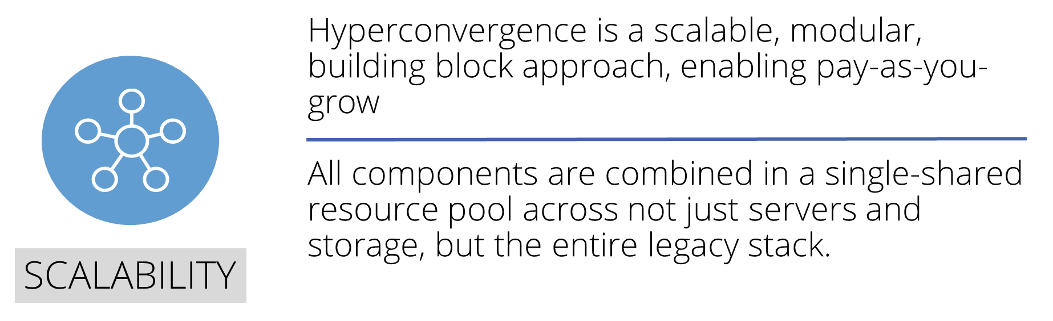
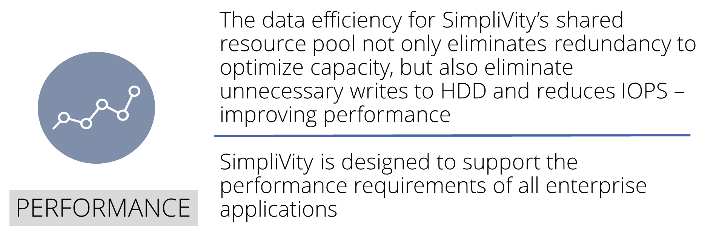
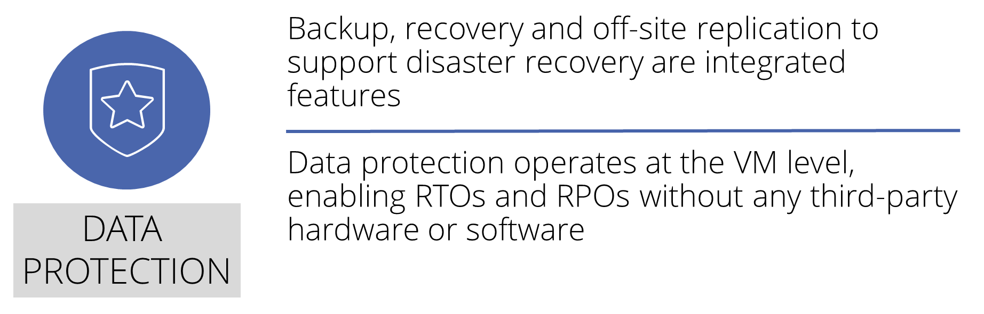
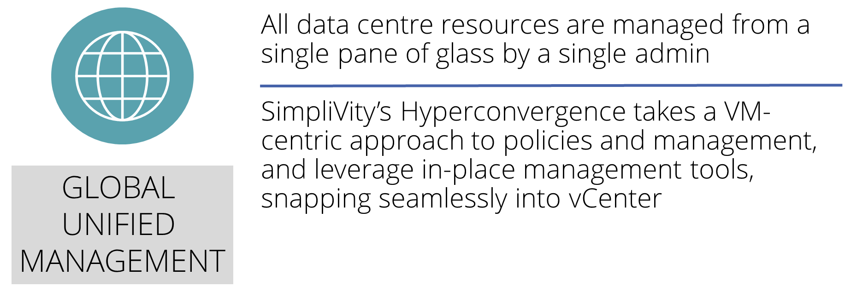
Get Hyperconverged with
and

Slide 4
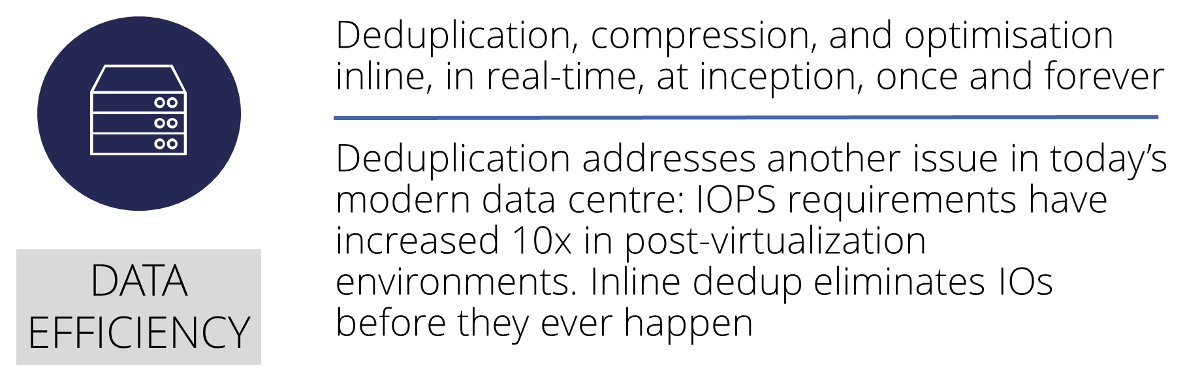
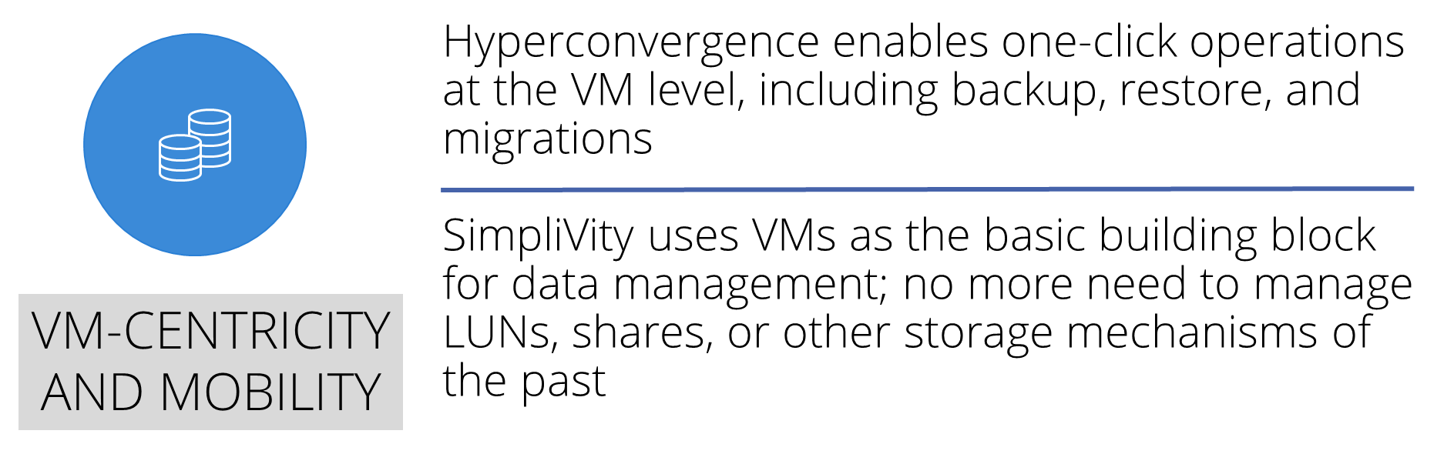
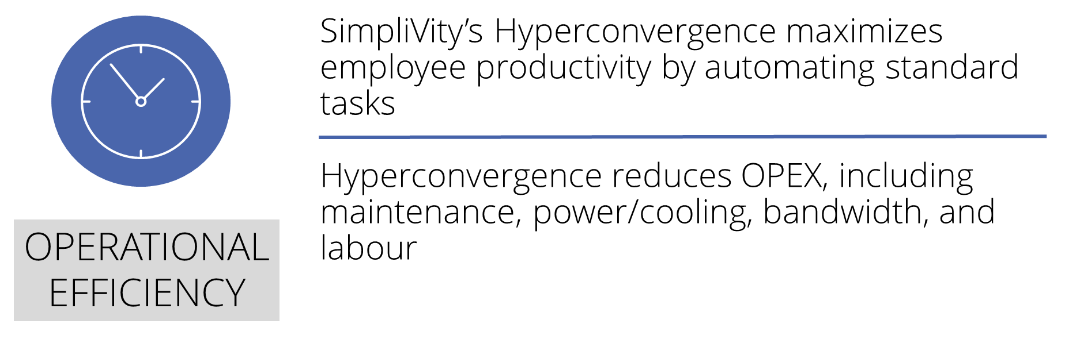
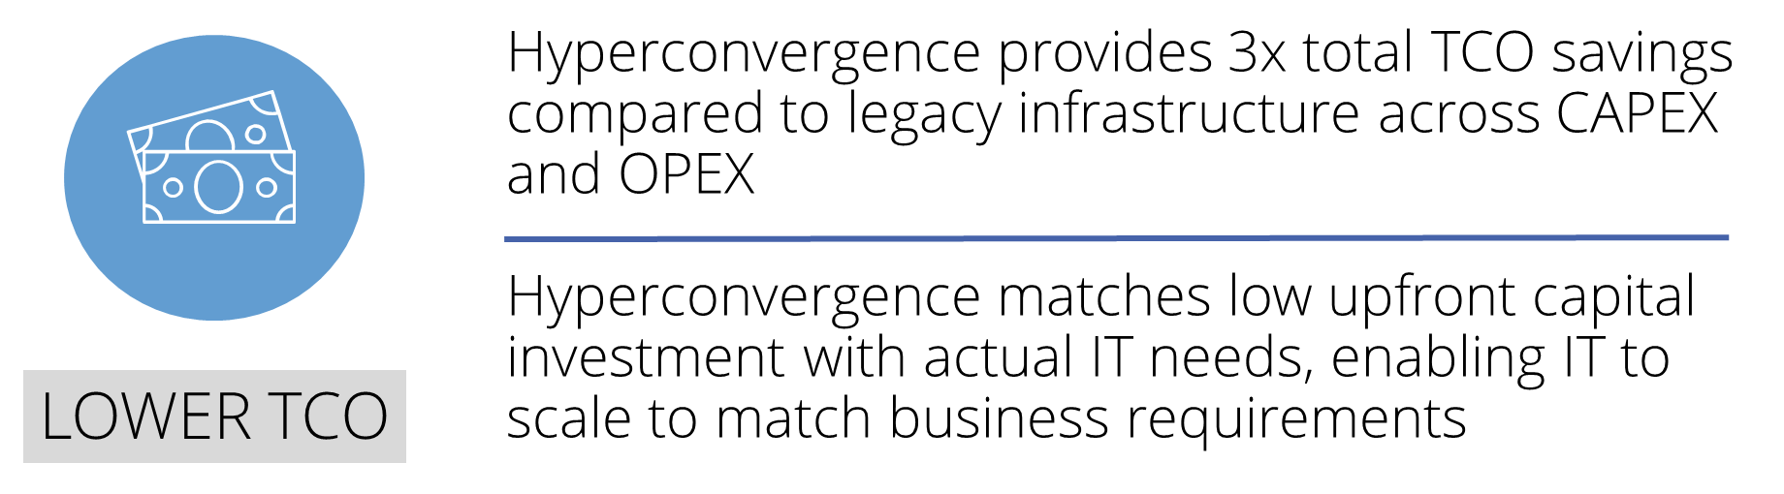
Get Hyperconverged with
and

Slide 5
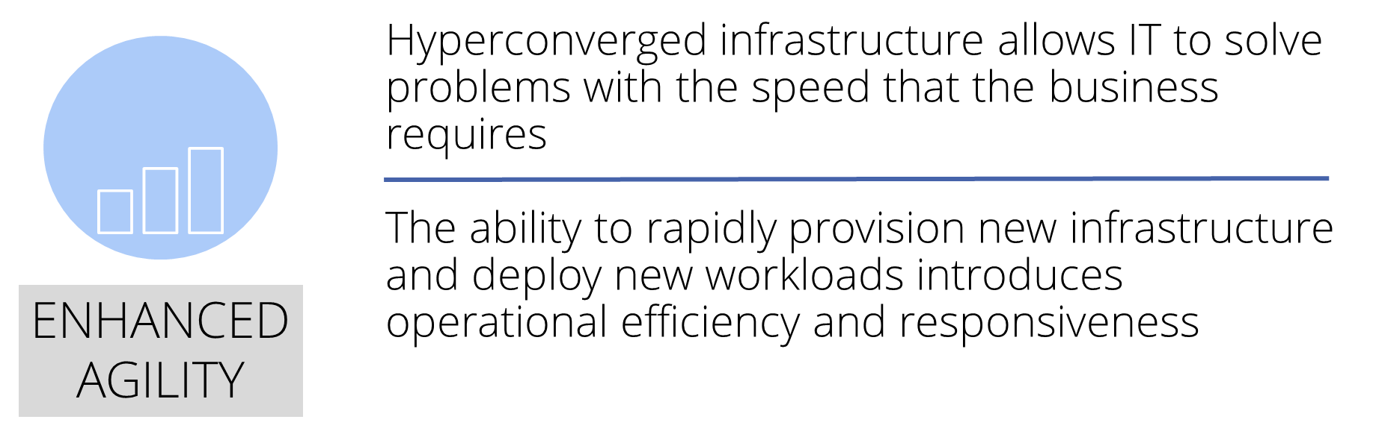
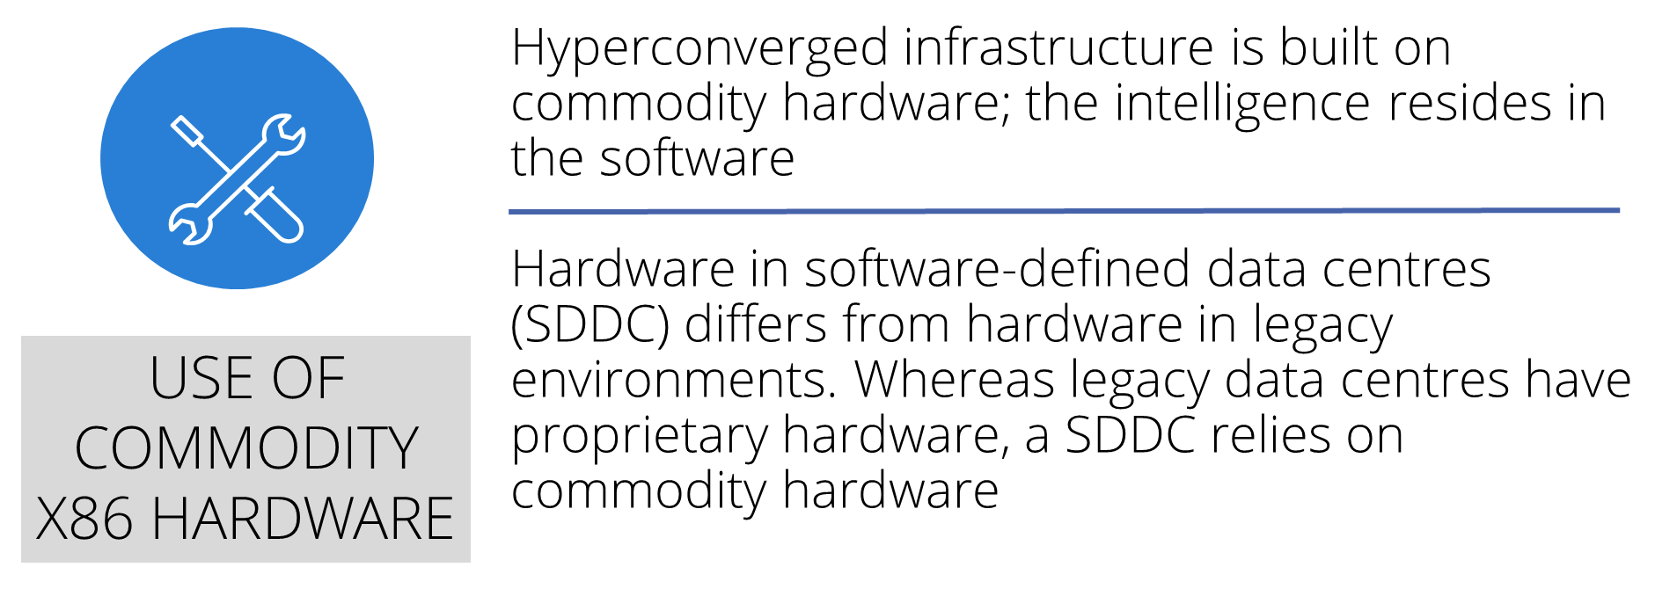
Get Hyperconverged with
and

Slide 6


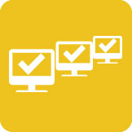
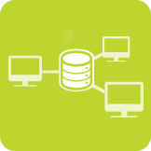


SimpliVity Use Cases
Test and Development
You needed test and development resources yesterday, but you’re left waiting. Development has slowed and your milestones and roadmap deliverables are at risk. Delivery date, cost or quality—something has to give. Or does it?
What if your developers could self-deploy virtual machines, inclusive of their associated storage? What if developers could clone a VM and its associated data in a few minutes? And, what if you could maximize the efficiency of your test/dev infrastructure?
SimpliVity hyperconverged infrastructure meets the needs of even the most demanding test/dev environments.
Data Center Consolidation
You promised to simplify IT and create highly efficient IT operations. You also expected to save money while modernizing your infrastructure. But is your data center consolidation initiative falling short of expectations? Even with meticulous planning, you’re vulnerable to service disruption, downtime and data loss on your consolidation journey.
What if you could avert these potential risks? SimpliVity hyperconverged infrastructure is the perfect solution to deliver data center consolidation.
VDI Implementation
Did you have a false start with VDI? Or maybe you’ve heard your peers’ war stories about VDI’s complexity, high costs, or IOPS and high latency causing unpredictable performance. Don’t give up yet. These challenges can be overcome.
Virtual desktop infrastructure (VDI) deployed on SimpliVity hyperconverged infrastructure enables cost-effective implementations with a positive end user experience.
Tier-1 Application Deployment
Most organizations have virtualized more than 50% of their workloads, which includes business-critical Tier-1 applications. With multiple workloads with different IO streams being multiplexed by the hypervisor, the result is random IO streams competing for resources, increasing IOPS required to service the virtual workloads. To resolve the performance problem, do you add more disk spindles? Over-provision storage? Implement flash?
Rather than driving up the cost per gigabyte of storage, deploying SimpliVity hyperconverged infrastructure to host Tier-1 applications delivers both performance and a lower TCO.

Slide 7
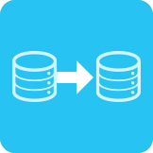
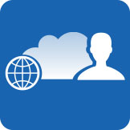

SimpliVity Use Cases
Remote Office/Branch Office
Do you face challenges managing your organization’s remote and branch office IT service delivery? Do you lack the resources, including on-site IT personnel, space- and power-efficient infrastructure, or the budget, to operate your remote site IT efficiently?
SimpliVity hyperconverged infrastructure streamlines IT deployment and centralizes multi-site management for global SimpliVity instances via a single interface.
Data Migration
What does new infrastructure deployment, technology refresh, and consolidation initiatives have in common? They all require data migration. If that’s not worrisome enough, you need to migrate data in in a way that minimizes risks, costs, and disruption.
SimpliVity hyperconverged infrastructure minimizes manual efforts and disruption typically associated with data migration, enabling faster time-to-deployment and time-to-market.
Cloud Computing
You want the ease of scale, agility and economics of public cloud infrastructure, without compromising on enterprise IT governance for performance, resiliency, and other functionality. That’s where private cloud computing or hybrid cloud computing come in.
On-premises private or hybrid cloud computing models are easily implemented on SimpliVity hyperconverged infrastructure to enable rapid and elastic scale in response to changing business needs.
Data Protection
Do you have an insurance policy in place for your applications and data? Has your backup and disaster recovery process or technology implementation become way too complicated? Are there SimpliVity hyperconverged infrastructure includes native data protection, providing VM-centric full backup and replication to your off-site location or cloud storage.

Slide 8
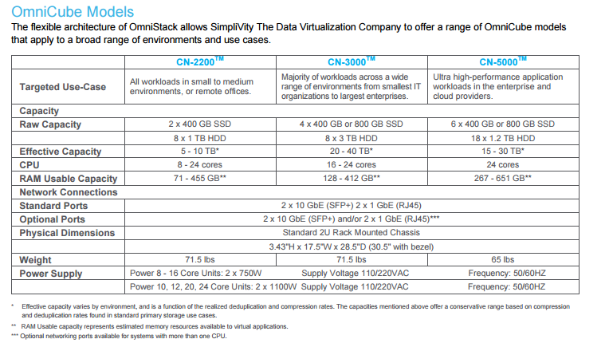
SimpliVity Product Range

Slide 9
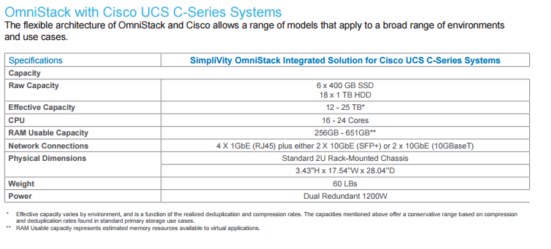
SimpliVity Product Range

Slide 10
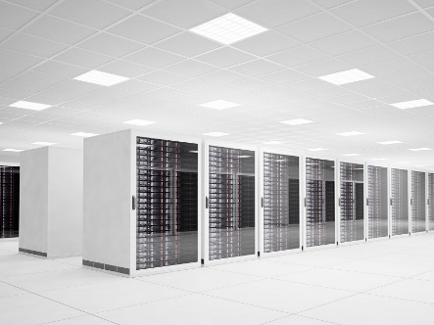


About 17 Ways
We are an Australian technology company providing hardware, software and advice to Australian businesses.
Hardware
17 Ways are a reseller of converged and commodity hardware solutions. We are working with a number of the leading international companies in this space. In addition to providing the best solutions for your business we can also provide integration and migration support and can advise on the organisational change required to get the most out of your infrastructure solutions. Alternatively, if you prefer, we can manage the entire system for you.
Software
17 Ways offer a full range of software development and maintenance services. With senior staff based in Sydney and access to a team of highly skilled programmers and testers, we can provide a high quality service to companies that need custom software development.
Advice
Technology is increasingly complex and business critical. Making the wrong technology decisions has far reaching consequences for any business. At 17 Ways we have the experience to help you across a range of technical areas including infrastructure, applications, integration, operations, organisational structure and strategy. We can provide advice or implement part or all of the solution for you.
17ways.com.au | info@17ways.com.au | +61 2 8964 8234 | Level 4, 167 Phillip Street, Sydney NSW 2000

